Slide 1
Finding the Subnet, Broadcast and Useable Host Ranges
Lecture 15
Topic:Carrier Sense Multiple Access (CSMA)

Slide 2
Introduction
The chance of collision can be reduced if a station senses the medium before trying to use it.
Carrier sense multiple access (CSMA) requires that each station first listen to the medium (or check the state of the medium) before sending.
In other words, CSMA is based on the principle "sense before transmit" or "listen before talk."

Slide 3

Cont.
CSMA can reduce the possibility of collision, but it cannot eliminate it. The reason for this is shown in Figure below, a space and time model of a CSMA network. Stations are connected to a shared channel (usually a dedicated medium).

Slide 4
Cont.
The possibility of collision still exists because of propagation delay; when a station sends a frame, it still takes time (although very short) for the first bit to reach every station and for every station to sense it.
In other words, a station may sense the medium and find it idle, only because the first bit sent by another station has not yet been received.

Slide 5
Cont.
At time t1 station B senses the medium and finds it idle, so it sends a frame. At timet2 (t2>t1)station C senses the medium and finds it idle because, at this time, the first bits from station B have not reached station C. Station C also sends a frame. The two signals collide and both frames are destroyed.

Slide 6
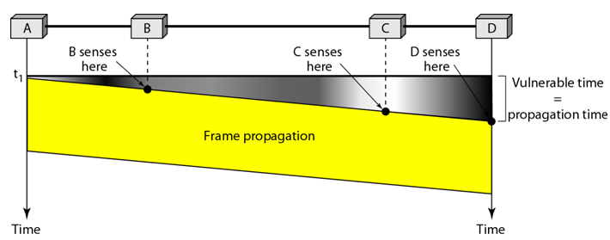
Vulnerable time in CSMA

Slide 7
Cont.
The vulnerable time for CSMA is the propagation time Tp .This is the time needed for a signal to propagate from one end of the medium to the other.
When a station sends a frame, and any other station tries to send a frame during this time, a collision will result.

Slide 8
Cont.
But if the first bit of the frame reaches the end of the medium, every station will already have heard the bit and will refrain from sending.
Figure shows the worst case The leftmost station A sends a frame at time t₁ which reaches the rightmost station D at time t₁ + T_{p} . The gray area shows the vulnerable area in time and space.

Slide 9
Persistence Methods
What should a station do if the channel is busy? What should a station do if the channel is idle? Three methods have been devised to answer these questions:
The I-persistent method,
The nonpersistent method,
And the p-persistent method.

Slide 10

The I-Persistence Methods
The I-persistent method is simple and straightforward. In this method, after the station finds the line idle, it sends its frame immediately.
This method has the highest chance of collision because two or more stations may find the line idle and send their frames immediately.

Slide 11
Nonpersistent method
In the nonpersistent method, a station that has a frame to send senses the line.
If the line is idle, it sends immediately.
If the line is not idle, it waits a random amount of time and then senses the line again.

Slide 12
Nonpersistent method
The nonpersistent approach reduces the chance of collision because it is unlikely that two or more stations will wait the same amount of time and retry to send simultaneously.
However, this method reduces the efficiency of the network because the medium remains idle when there may be stations with frames to send.

Slide 13
P-persistent method
The p-persistent method is used if the channel has time slots with slot duration equal to or greater than the maximum propagation time.
The p-persistent approach combines the advantages of the other two strategies.
It reduces the chance of collision and improves efficiency.

Slide 14
P-persistent method
In this method, after the station finds the line idle it follows these steps:
  With probability p, the station sends its frame.
  With probability q = 1 - p, the station waits for the beginning of the next time slot and checks the line again.
  If the line is idle, it goes to step 1
  If the line is busy, it acts as though a collision has occurred and uses the backoff procedure.

Slide 15
P-persistent method

Slide 16
Carrier Sense Multiple Access with Collision Detection (CSMA/CD)
The CSMA method does not specify the procedure following a collision. Carrier senses multiple access with collision detection (CSMA/CD) augments the algorithm to handle the collision.
In this method, a station monitors the medium after it sends a frame to see if the transmission was successful. If so, the transmission is finished.

Slide 17
Carrier Sense Multiple Access with Collision Detection (CSMA/CD)
If, however, there is a collision (excess current above what it is generating, i.e. > 24 mA for coaxial Ethernet), it stops transmission immediately and instead transmits a 32-bit jam sequence. The purpose of this sequence is to ensure that any other node which may currently be receiving this frame will receive the jam signal in place of the correct 32-bit MAC CRC, this causes the other receivers to discard the frame due to a CRC error.

Slide 18
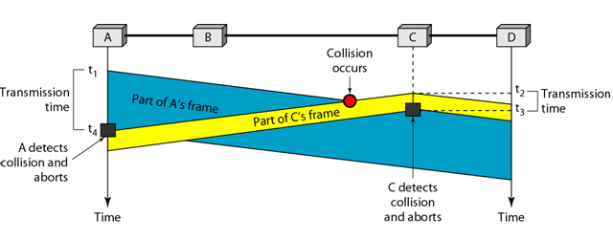
Cont.
To better understand CSMA/CD, let us look at the first bits transmitted by the two stations involved in the collision. Although each station continues to send bits in the frame until it detects the collision, we show what happens as the first bits collide. In Figure below, stations A and C are involved in the collision.

Slide 19
Cont.
At time t1, station A has executed its persistence procedure and starts sending the bits of its frame.
At time t2, station C has not yet sensed the first bit sent by A.
Station C executes its persistence procedure and starts sending the bits in its frame, which propagate both to the left and to the right.

Slide 20
Cont.
The collision occurs sometime after time t2. Station C detects a collision at time t3 when it receives the first bit of A's frame.
Station C immediately (or after a short time, but we assume immediately) aborts transmission. Station A detects collision at time t4 when it receives the first bit of C's frame; it also immediately aborts transmission.

Slide 21
Cont.
Looking at the figure, we see that A transmits for the duration t4 - tl; C transmits for the duration t3 –t2. At time t4, the transmission of A’s frame, though incomplete, is aborted; at time t3, the transmission of C's frame, though incomplete, is aborted.

Slide 22

CSMA/CD flow diagram

Slide 23
Minimum Frame size
For CSMA/CD to work, we need a restriction on the frame size.
Before sending the last bit of the frame, the sending station must detect a collision, if any, and abort the transmission.
This is so because the station, once the entire frame is sent, does not keep a copy of the frame and does not monitor the line for collision detection.
Therefore, the frame transmission time T_{fr} must be at least two times the maximum propagation time Tp.

Slide 24
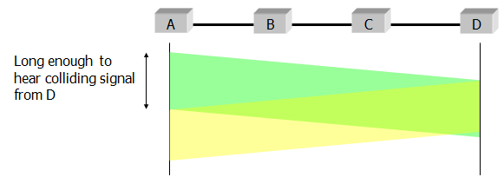
Cont.
Each frame must be large enough for a sender to detect a collision
Worst case scenario:
  "A" is transmitting
  "D" starts transmitting just before A's signal arrives

Slide 25
Controlled Access
A station must be authorized by someone (e.g., other stations) before transmitting
Three common methods:
  Reservation
  Polling
  Token passing

Slide 26

Reservation
Stations take turns transmitting a single frame at a full rate ( R ) bps
Transmissions are organized into variable length cycles
Each cycle begins with a reservation interval that consists of (N) minislots. One minislot for each of the N stations
When a station needs to send a data frame, it makes a reservation in its own minislot.

Slide 27
Reservation-Cont.
By listening to the reservation interval, every station knows which stations will transfer frames, and in which order.
The stations that made reservations can send their data frames after the reservation frame.

Slide 28
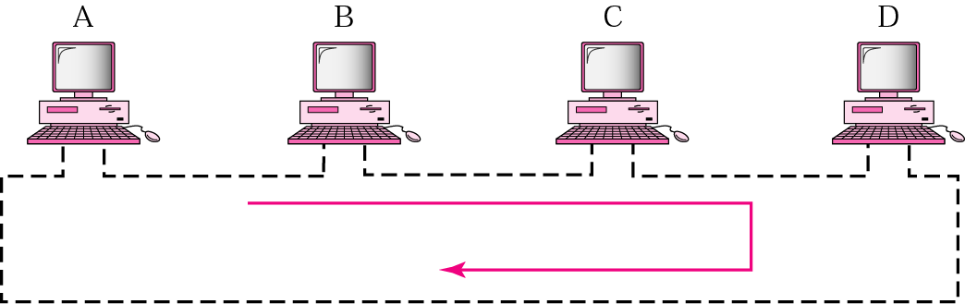
Token Passing
In the token-passing method, a station is authorized to send data when it receives a special frame called a token.
In this method, stations are arranged around a ring.
Each station has a predecessor and a successor.
Frames are coming from the predecessor and going to the successor.

Slide 29
Cont.
Proposed in 1969 and initially referred to as a Newhall ring.
Token ring :a number of stations connected by transmission links in a ring topology. Information flows in one direction along the ring from source to destination and back to source.
Medium access control is provided by a small frame, the token, that circulates around the ring when all stations are idle. Only the station possessing the token is allowed to transmit at any given time.

Slide 30
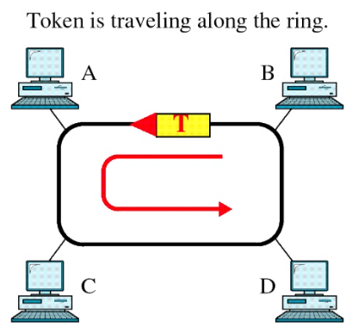
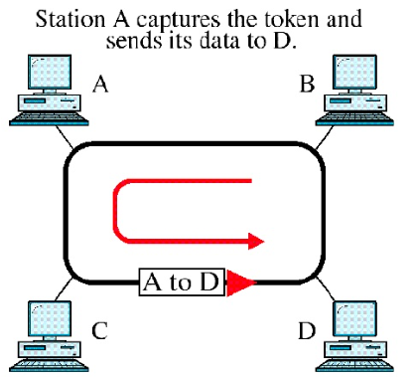
Access Method: Token Passing

Slide 31
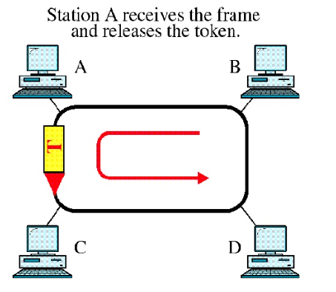
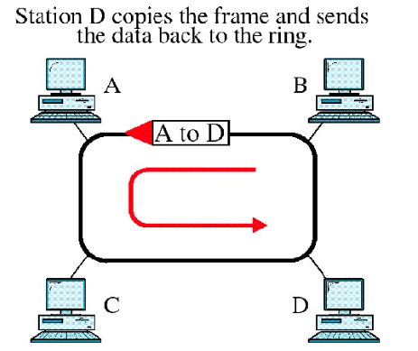
Cont.

Slide 32
Access Method Cont.
Whenever the network is unoccupied, it circulates a simple three byte token.
The token is passed from NIC to NIC in sequence until it encounters a station with data to send.
That station waits for the token to enter its network board.
It keeps the token and sets a bit inside its NIC as a remainder that is has done so, then sends its one data frame.

Slide 33
Access Method Cont.
This data frame proceeds around the ring, being regenerated by each station.
Each intermediate station examines the destination address, finds that the frame is addresses to another station, and relays it to its neighbors.
The intended recipient recognizes its own address, copies the message, check the errors, and changes four bits in the last byte of the frame to indicate address recognized and frame copied.
The full packet then continues around the ring until it returns to the sender that sent it.

Slide 34
Access Method Cont.
The sender receives the frame and recognizes itself in the source address field.
It then examines the address-recognized bits. If they are set, it knows that the frame was received.
The sender then discards the used data frame and release the token back to the ring.

Slide 35
Priority and Reservation
Generally, once a token has been released, the next station on the ring with data to send has the right to take charge of the ring.
However another option is possible.
The busy token can be reserved by a station waiting to transmit regardless of the station’s location on the ring.
Each station has a priority code.
As a frame passes by, a station waiting to transmit may reserve the next open token by entering its priority code in the access control (AC) field of the token or data frame.

Slide 36
Priority and Reservation
A station with a higher priority may remove a lower priority reservation and replace it with its own.
Among stations of equal priority, the process is first-come, first served.
Through this mechanism, the station holding the reservation gets the opportunity to transmit as soon as the token is free, whether or not it comes next physically on the ring.

Slide 37
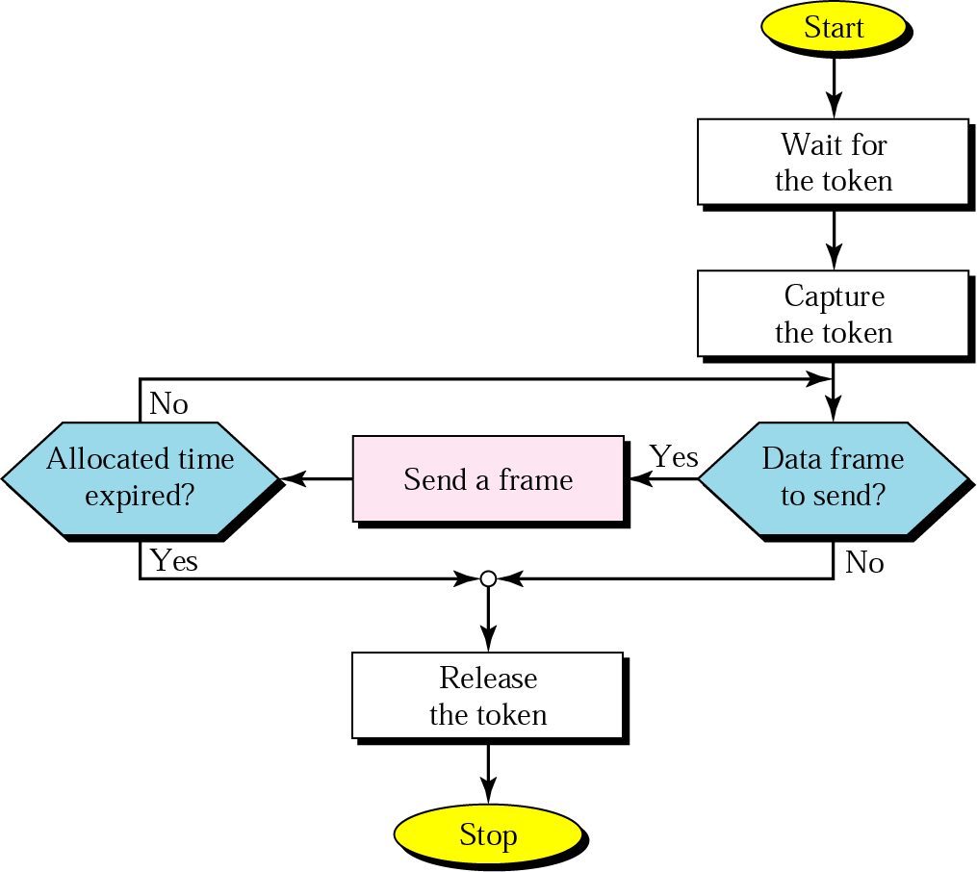
Cont.

Slide 38
Polling
Polling works with topologies in which one device is designed as a primary station and the other devices are secondary stations.
All data exchange must be made through the primary device even when the ultimate destination is a secondary device.
The primary device control the links; the secondary devices follow its instructions.
It is up to the primary device to determine which device is allowed to use the channel at a given time.

Slide 39
Polling-Cont.
The primary device, therefore is always the initiator of a session.
If the primary station wants to receive data, it asks the secondaries if they have anything to send; is function is called polling.
If the primary device wants to send data, it tells the secondary target to get ready to receive; this function is called selecting.

Slide 40
Select
The select mode is used whenever the primary device has something to send.
It is mentioned that the primary controls the link.
If the primary is neither sending nor receiving data, it knows the link is available.
If it has something to send, the primary device sends it.
What it does not know, however, is whether the target device is prepared to receive.

Slide 41
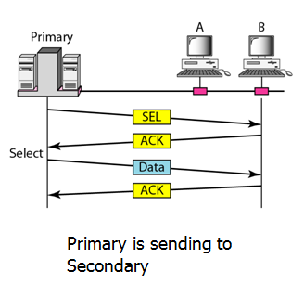
Select-Cont.
So the primary must alert the secondary to the upcoming transmission and wait for an acknowledgement of the secondary’s ready station.
Before sending data, the primary creates and transmits a select (SEL) frame, one field of which includes the address of the intended secondary.

Slide 42
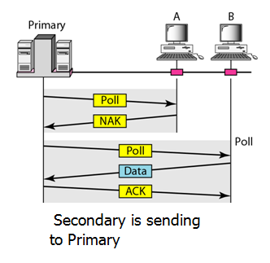
Poll
The polling function is used by the primary device to solicit transmissions from the secondary devices.

Slide 43
Poll-Continue
When the primary is ready to receive data, it must ask (poll) each device in turn if it has anything to send.
When the first secondary is approached, it responds either with a NAK frame it has nothing to send or with data (in the form of a data frame) if it does.
If the response in negative (a NAK frame), the primary then polls the next secondary in the same manner until it finds one with data to send.
When the response is positive (a data frame), the primary reads the frame and returns an acknowledgement (ACK), verifying its receipt.

